Slide 1
School of Geography and Geology McMaster University
Applied Spatial Statistics
The Potential of Spatial Data
(and some caveats)

Slide 2
Spatial vs. Aspatial Data
How are spatial and aspatial data different?

Slide 3
Aspatial Data: Examples
Salary of professional baseball players
Concrete’s strength tests
Development of new drugs

Slide 4
Spatial Data: Examples
Location of bank branches
Groundwater pressure measurements
Population density

Slide 5
Analysis of Spatial Data
Opportunities for inquiry and discovery
Location is an attribute
Relations in two dimensions
Types of spatial relations?
Notes:
Distance, adjacency, interaction, neighborhood

Slide 6
Analysis of Spatial Data
Essential from a statistical viewpoint
Need for robust, sufficient methods
Notes:
Distance, adjacency, interaction, neighborhood

Slide 7
Analysis of Spatial Data
What is a robust method?

Slide 8
Analysis of Spatial Data
Sufficiency criterion

Slide 9
Analysis of Spatial Data
Sufficiency criterion

Slide 10
Spatial Data Analysis
Caveats

Slide 11
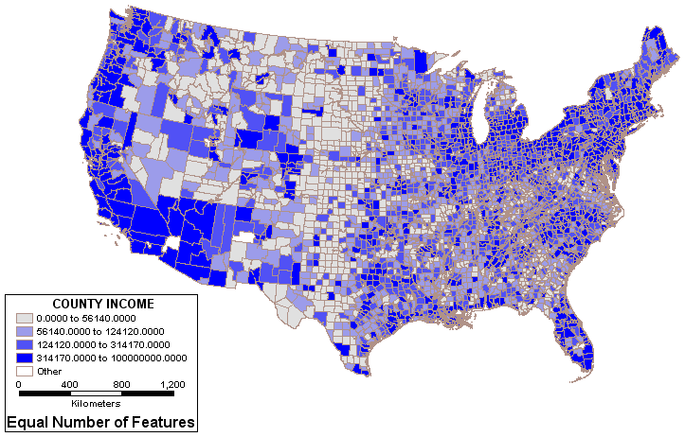
How to Lie with Maps
County income in the US

Slide 12
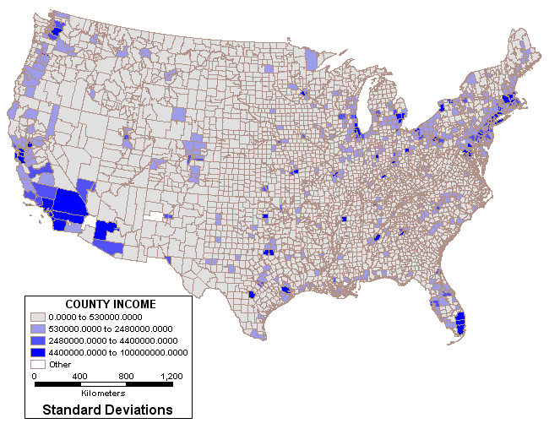
How to Lie with Maps
County income in the US

Slide 13
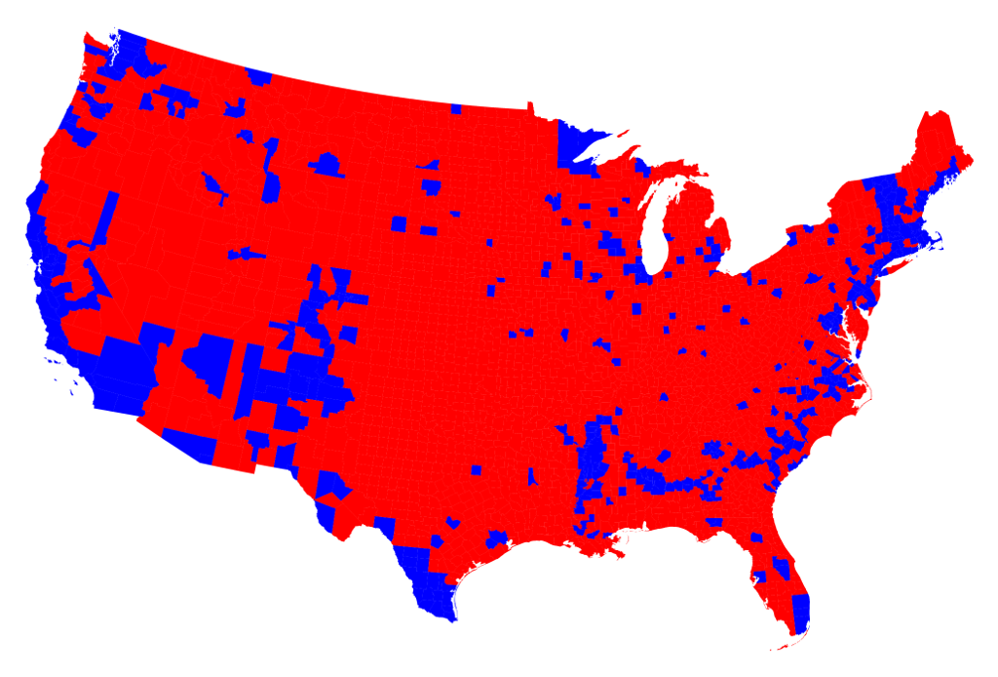
How to Lie with Maps
US 2016 Election results
http://www-personal.umich.edu/~mejn/election/2016/

Slide 14
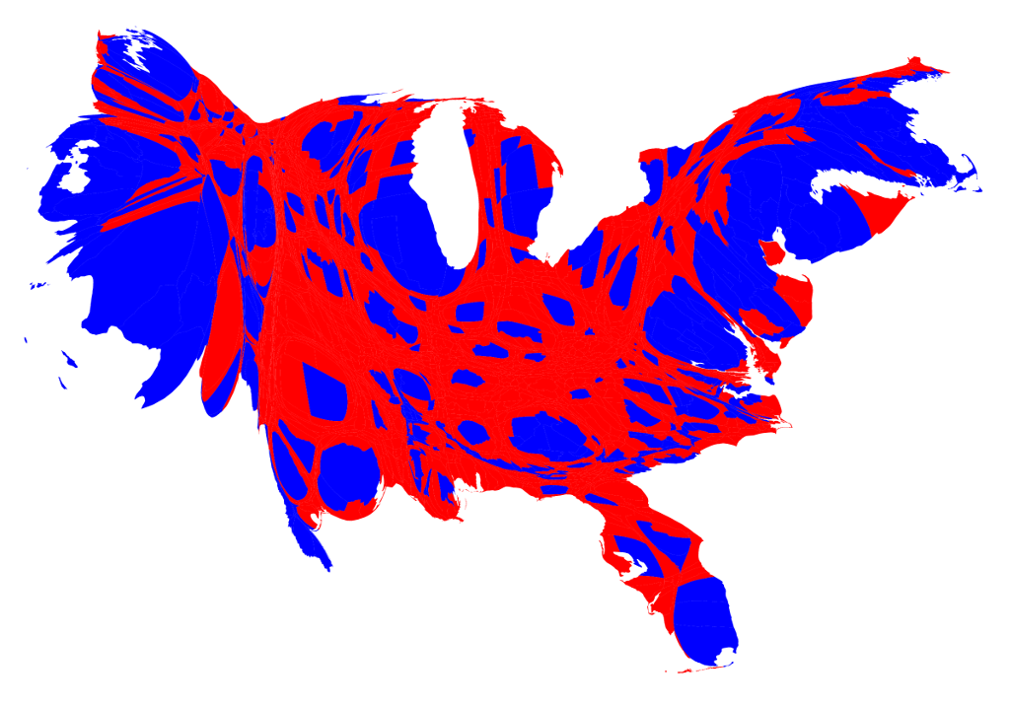
How to Lie with Maps
US 2004 Election results

Slide 15
Modifiable Areal Unit Problem (MAUP)
5
6
3
7
2
2
2
5
4

Slide 16
Modifiable Areal Unit Problem (MAUP)
5
6
6
3
2.33
7
2
2
3.5
4
2
5
4

Slide 17
Modifiable Areal Unit Problem (MAUP)
5
5.5
6
3
4.66
7
2
2
2
4.5
2
5
4

Slide 18
Modifiable Areal Unit Problem (MAUP)
6
2.33
3.5
4

Slide 19
Modifiable Areal Unit Problem (MAUP)
5.5
4.66
2
4.5

Slide 20
MAUP and Correlation
Y
X

Slide 21
MAUP and Correlation
“A million or so correlation coefficients”
Stan Openshaw

Slide 22
MAUP
Patterns are specific to zoning system
If zoning system changes, results cannot be generalized

Slide 23
Next
Maps as Processes

